Slide 1

Skin detection project
By Jacob Graham

Slide 2
Introduction
As part of my course: algorithm multimedia and machine learning in python, I developed an application that connects to the PC web cam and analyze the video by detecting human skin and coloring it in green.
An additional feature of the app is to record video , take photos , and save them as a new avi/png file.

Slide 3
What is skin detection?
Process of finding skin-colored pixels and regions in an image or a video.
The color of human skin is created by a combination of blood (red) and melanin (yellow, brown).
What we need is a function which can tell whether a given color pixel is a skin pixel or not.
Range based skin detection technique
transform a given pixel into an appropriate color space
skin classifier to label the pixel whether it is a skin or non skin pixel.

Slide 4
color space
When colors need to be used in digital media so to needs to be presented in numbers. Therefore color space is a set of rules that allows describing colors with numbers.
RGB color space uses Red- Green-Blue component of the color and use those component to display the color.
RGB Not much useful for skin detection, therefore we will convert the image to YCrCb color space.

Slide 5
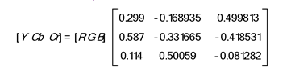
YCrCb color space
Y is the luma component of the color. Luma component is the brightness of the color. That means the light intensity of the color.
Cr and Cb is the red and blue component’s related to the chroma component. That means:
Cb is the blue relative to the green component, Cr is the red relative to the green component
Cb = B – Y , Cr = R – Y
Conversion:

Slide 6
OpenCV library
OpenCV is the main library in this project.
By using the above function’s:
VideoCapture
waitKey
flip
cvtColor
COLOR_BGR2YCR_CB
GaussianBlur
inRange
bitwise_and
bitwise_or
VideoWriter
imwrite
imshow

Slide 7
Detection Process Diagram
Video capture
Display
Convert BGR to YCrCb
BGR image OR Green image
Bitwise OR
Gaussian Bluer
Decrease noise
image *= [1,255,1]
Color in green
Min < image < Max
In Range
Bitwise AND
BGR image ^ inRange image

Slide 8
Detection Process
At first, we set two NumPy array as the min_YCrCb and max_YCrCb for the detection range of human skin pixels.
Min_YCrCb[40, 140, 77]
Max_ YCrCb[150, 170, 127]
The array’s are set as unsigned int.

Slide 9
Detection Process
connect to the camera and analyzing the video fame by frame.
The live video is Capture frame-by-frame
Flip the frame 180* to make a mirror effect.

Slide 10
Detection Process
Convert the frame from BGR to YCrCb
RGB: (Red-Green-Blue) Defined in relation to primary colors(like CMYK). Not much useful for skin detection
YCrCb: Widely used since the skin pixels form a compact cluster in the Cb-Cr plane.

Slide 11
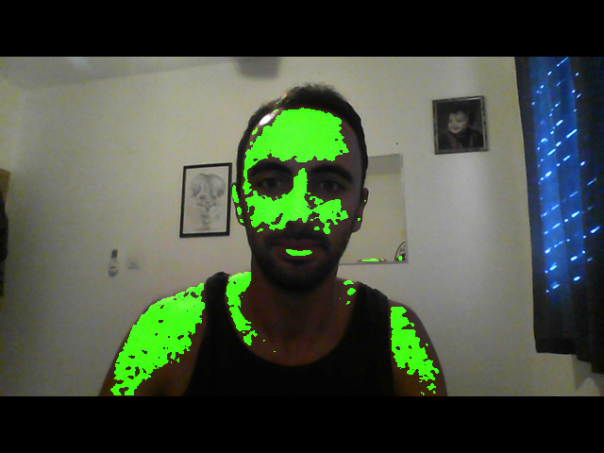
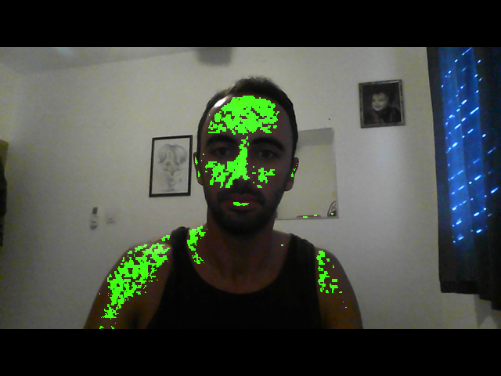
Detection Process
Apply a Gaussian mask size (3,3) on the image to decrease noise and improve detection range
An example of the outcome:
with mask without mask

Slide 12
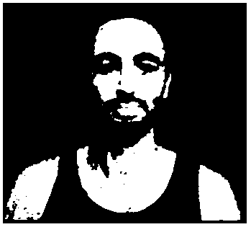
Detection Process
By using the range YCrCb arrays we scan the YCrCb Converted image.
Create a mask in the size of the image the has only value’s: 0 and 255.
Where skin = in range = 255
No skin = out of range = 0

Slide 13
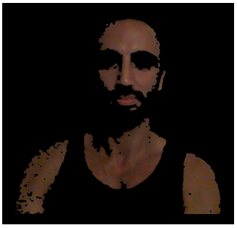
Detection Process
Create a new image by using the AND operation between the camera frame and the mask image.
This is cutting from the fame the pixel’s where skin is detected, and all the other pixel’s will be black.
Black AND pixel = Black
White AND pixel = pixel

Slide 14
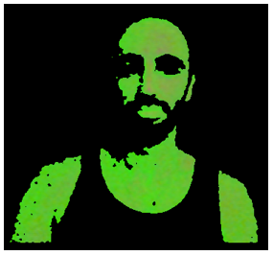
Detection Process
Take the previous image and multiply all the pixel by [1 , 255 , 1]
Now the skin is green as needed

Slide 15
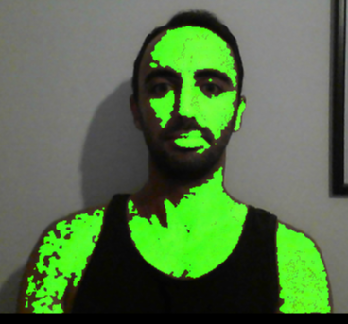
Detection Process
Applying OR operation between the camera frame and our green skin image.
The OR will make sure all the frame pixels that are nor skin will remain the same
And all the pixels that are skin will be green
This is the outcome:

Slide 16
Application usage
By Pressing the above:
‘q’ – exit
‘d’ – take a photo
‘s’ – start recording. Press again to stop.
‘p’ – pause video

Slide 17
Saving video and image
By checking the project directory we make sure the new file that we create wouldn’t override the previous one.
The file name is “file_i” , i = unsigned integer.
We find the latest i and create a new file with i+1.

Slide 18
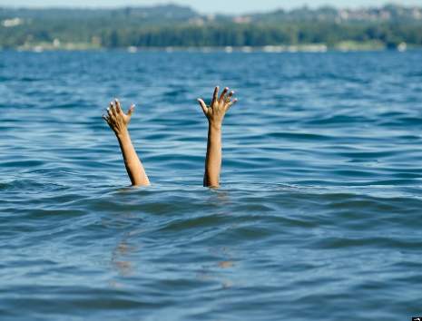
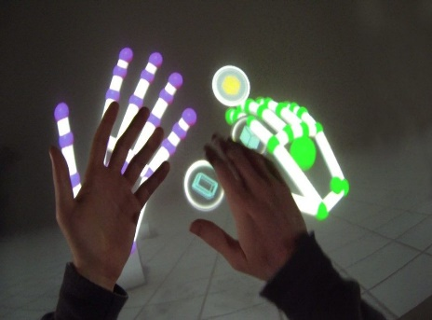
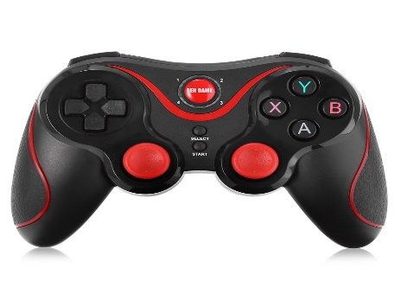
Future Development
This technology can be used for many purposes. For example:
Life saving
Gesture trucking
Replacing a video game controller

Slide 19
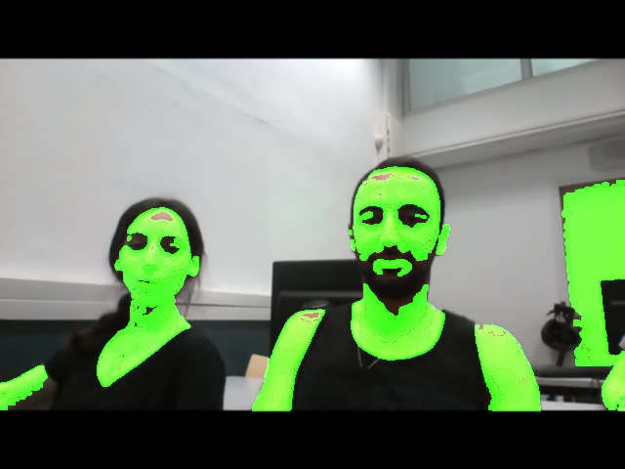
The END

